Slide 1

Downscaling European decarbonization scenarios of the heating sector to the Austrian community level
Assessing the heat density gap of centralized heat networks between 2050 and today
Sebastian Zwickl-Bernhard¹, Daniel Huppmann²
¹Energy Economics Group (EEG), Technische Universität Wien
²International Institute for Applied Systems Analysis
Corresponding author/Presenter: zwickl@eeg.tuwien.ac.at https://github.com/sebastianzwickl
Young Scientist Summer Program 2021 Final colloquium presentation 21/08/25

Slide 2
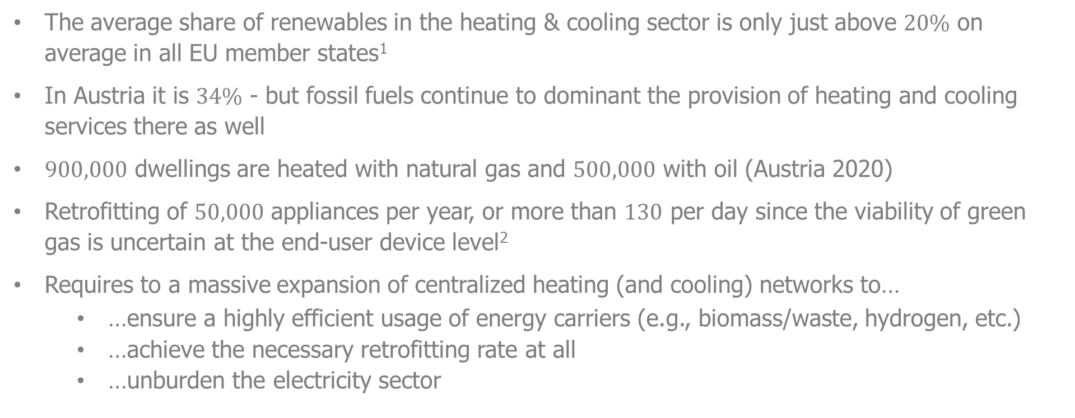
The scope of changes in the European heating sector
The average share of renewables in the heating & cooling sector is only just above $20\%$ on average in all EU member states¹
In Austria it is $34\%$ - but fossil fuels continue to dominant the provision of heating and cooling services there as well
$900,000$ dwellings are heated with natural gas and $500,000$ with oil (Austria 2020)
Retrofitting of $50,000$ appliances per year, or more than $130$ per day since the viability of green gas is uncertain at the end-user device level²
Requires to a massive expansion of centralized heating (and cooling) networks to…
…ensure a highly efficient usage of energy carriers (e.g., biomass/waste, hydrogen, etc.)
…achieve the necessary retrofitting rate at all
…unburden the electricity sector
¹Eurostat https://ec.europa.eu/eurostat/web/products-eurostat-news/-/ddn-20200211-1
²Zwickl-Bernhard & Auer, Energy, (2021). doi: 10.1016/j.energy.2021.121805

Slide 3
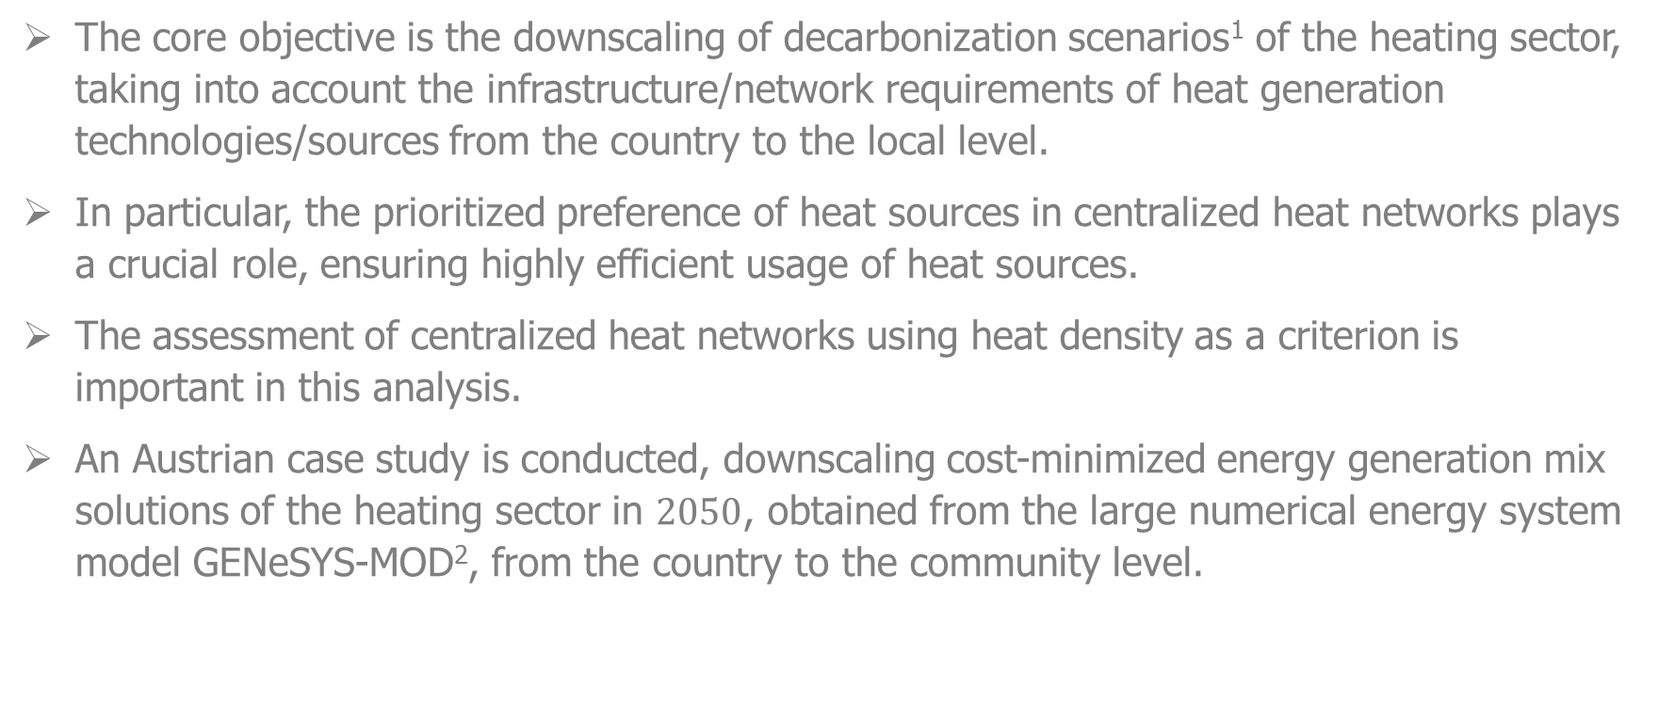
The core objective of this work
The core objective is the downscaling of decarbonization scenarios¹ of the heating sector, taking into account the infrastructure/network requirements of heat generation technologies/sources from the country to the local level.
In particular, the prioritized preference of heat sources in centralized heat networks plays a crucial role, ensuring highly efficient usage of heat sources.
The assessment of centralized heat networks using heat density as a criterion is important in this analysis.
An Austrian case study is conducted, downscaling cost-minimized energy generation mix solutions of the heating sector in $2050$, obtained from the large numerical energy system model GENeSYS-MOD², from the country to the community level.
¹Developed in the European H2020 project openENTRANCE aiming for the 1.5/2.0°C global warming climate target
²Löffler et al., Energies, (2017). doi: 10.3390/en10101468

Slide 4
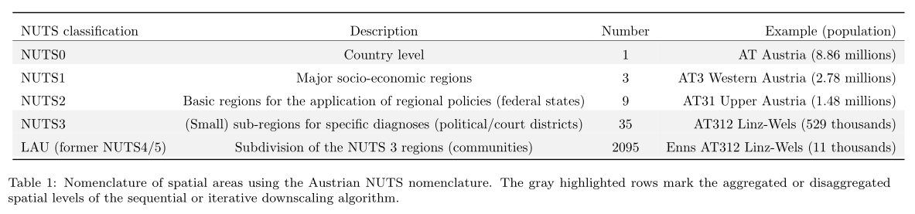
Methodology
Three different scenario-independent downscaling techniques
Proportional downscaling using population as a proxy (NUTS0 to the LAU level)
Sequential downscaling algorithm using population density and infrastructure requirements of heat technologies/sources as additional criterion (NUTS0 to the NUTS3)
Iterative downscaling algorithm based on graph-theory benchmarking (NUTS3 to the LAU level)

Slide 5
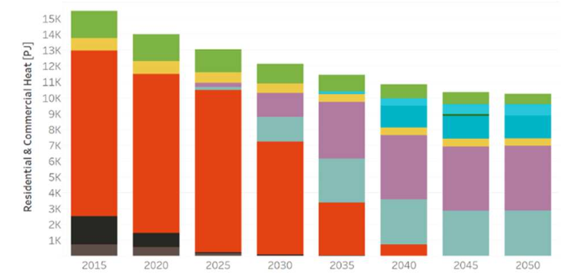
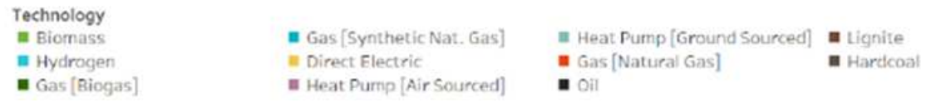
Numerical example and scenarios
Four different decarbonization scenarios of the European energy system aiming for the 1.5/2.0°C global warming climate target¹
Directed Transition scenario (strong policy incentives)
Societal Commitment scenario (strong societal acceptance, decentralized renewables)
Techno-Friendly scenario (market-driven breakthrough of renewables)
Gradual Development scenario (“little of each”)
Values of the decarbonized heating sector in Austria 2050 obtained by the large-numerical energy system model GENeSYS-MOD
c) Techno-Friendly
2050
¹Scenario a) to c) considers the 1.5°C global warming target and d) the less ambitious 2.0°C.

Slide 6
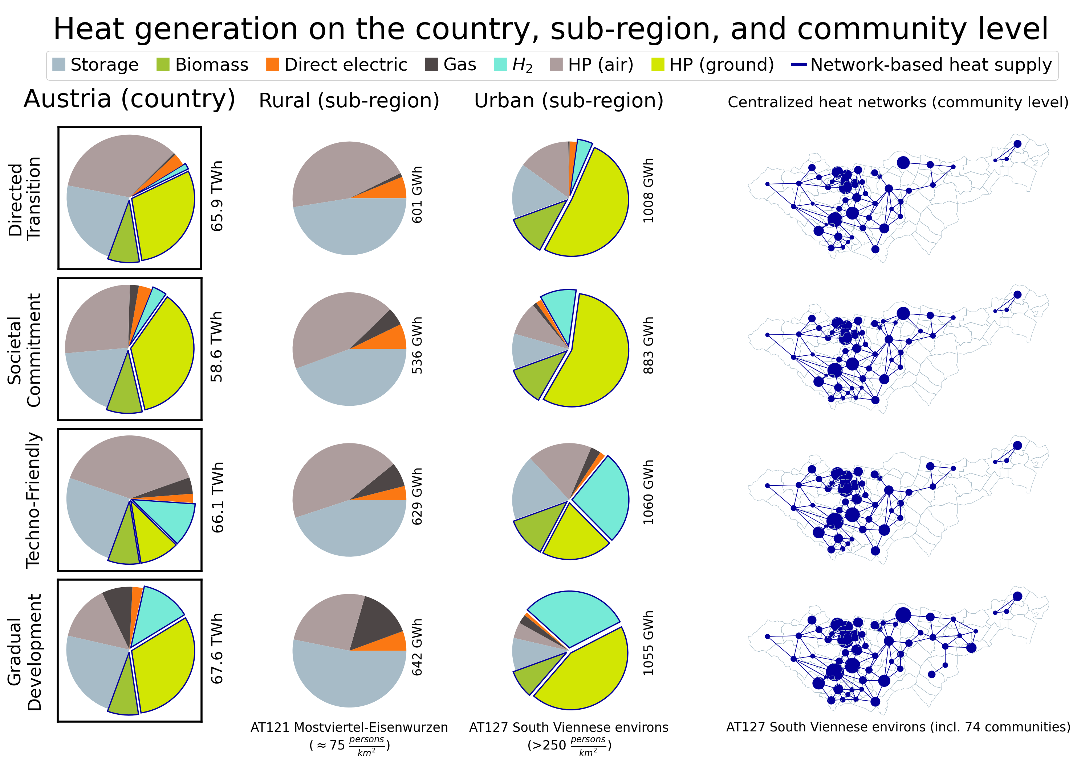

Slide 7
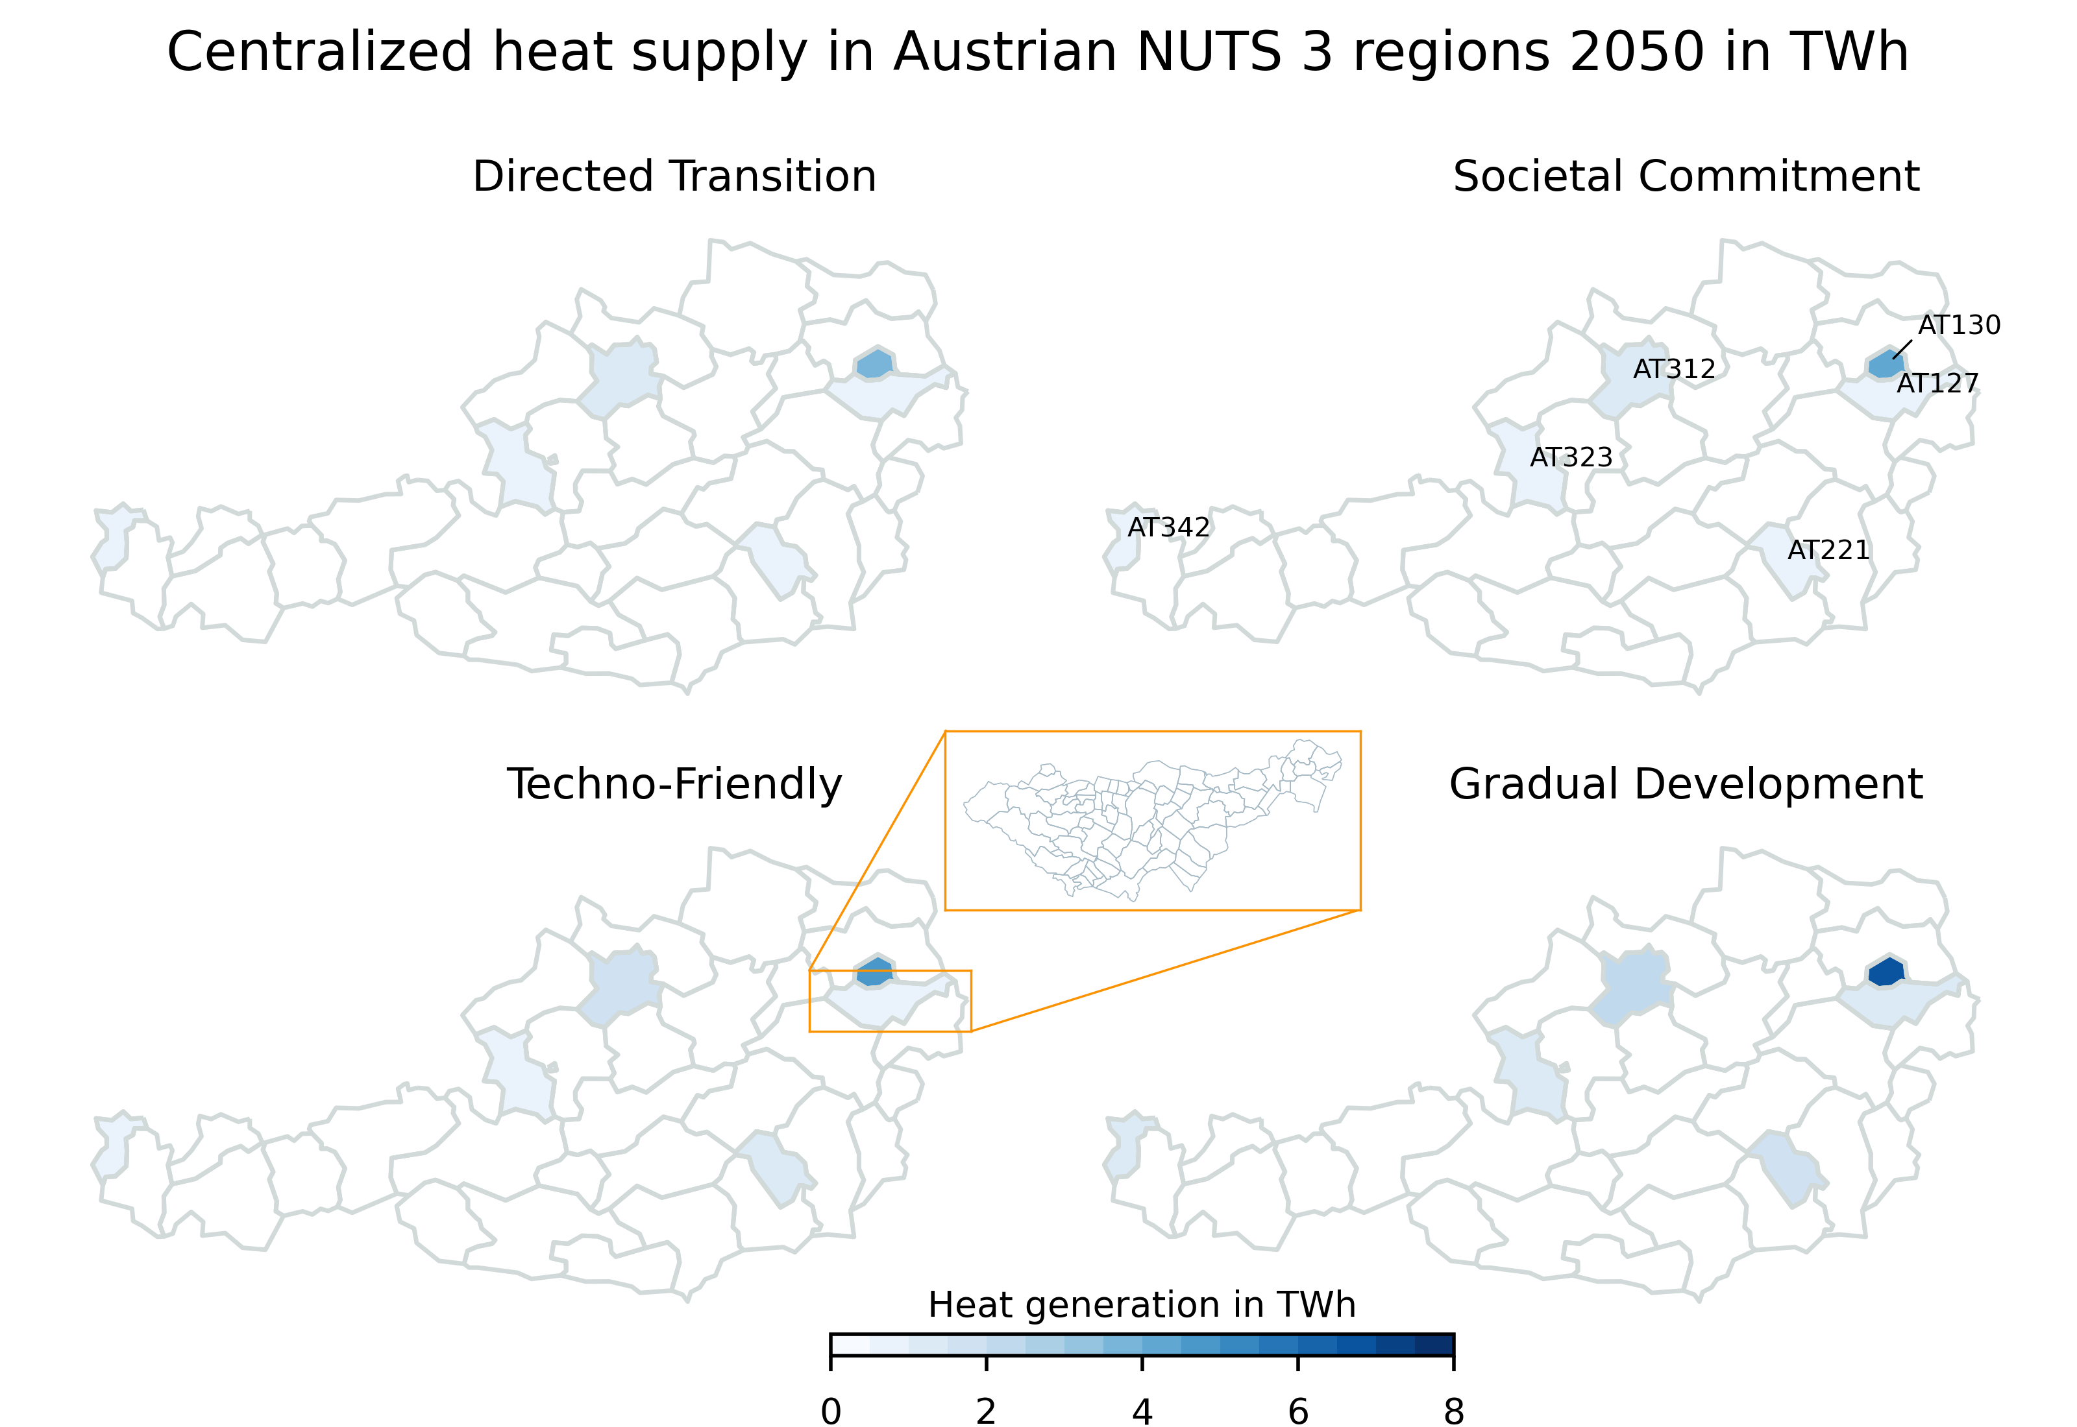

Slide 8
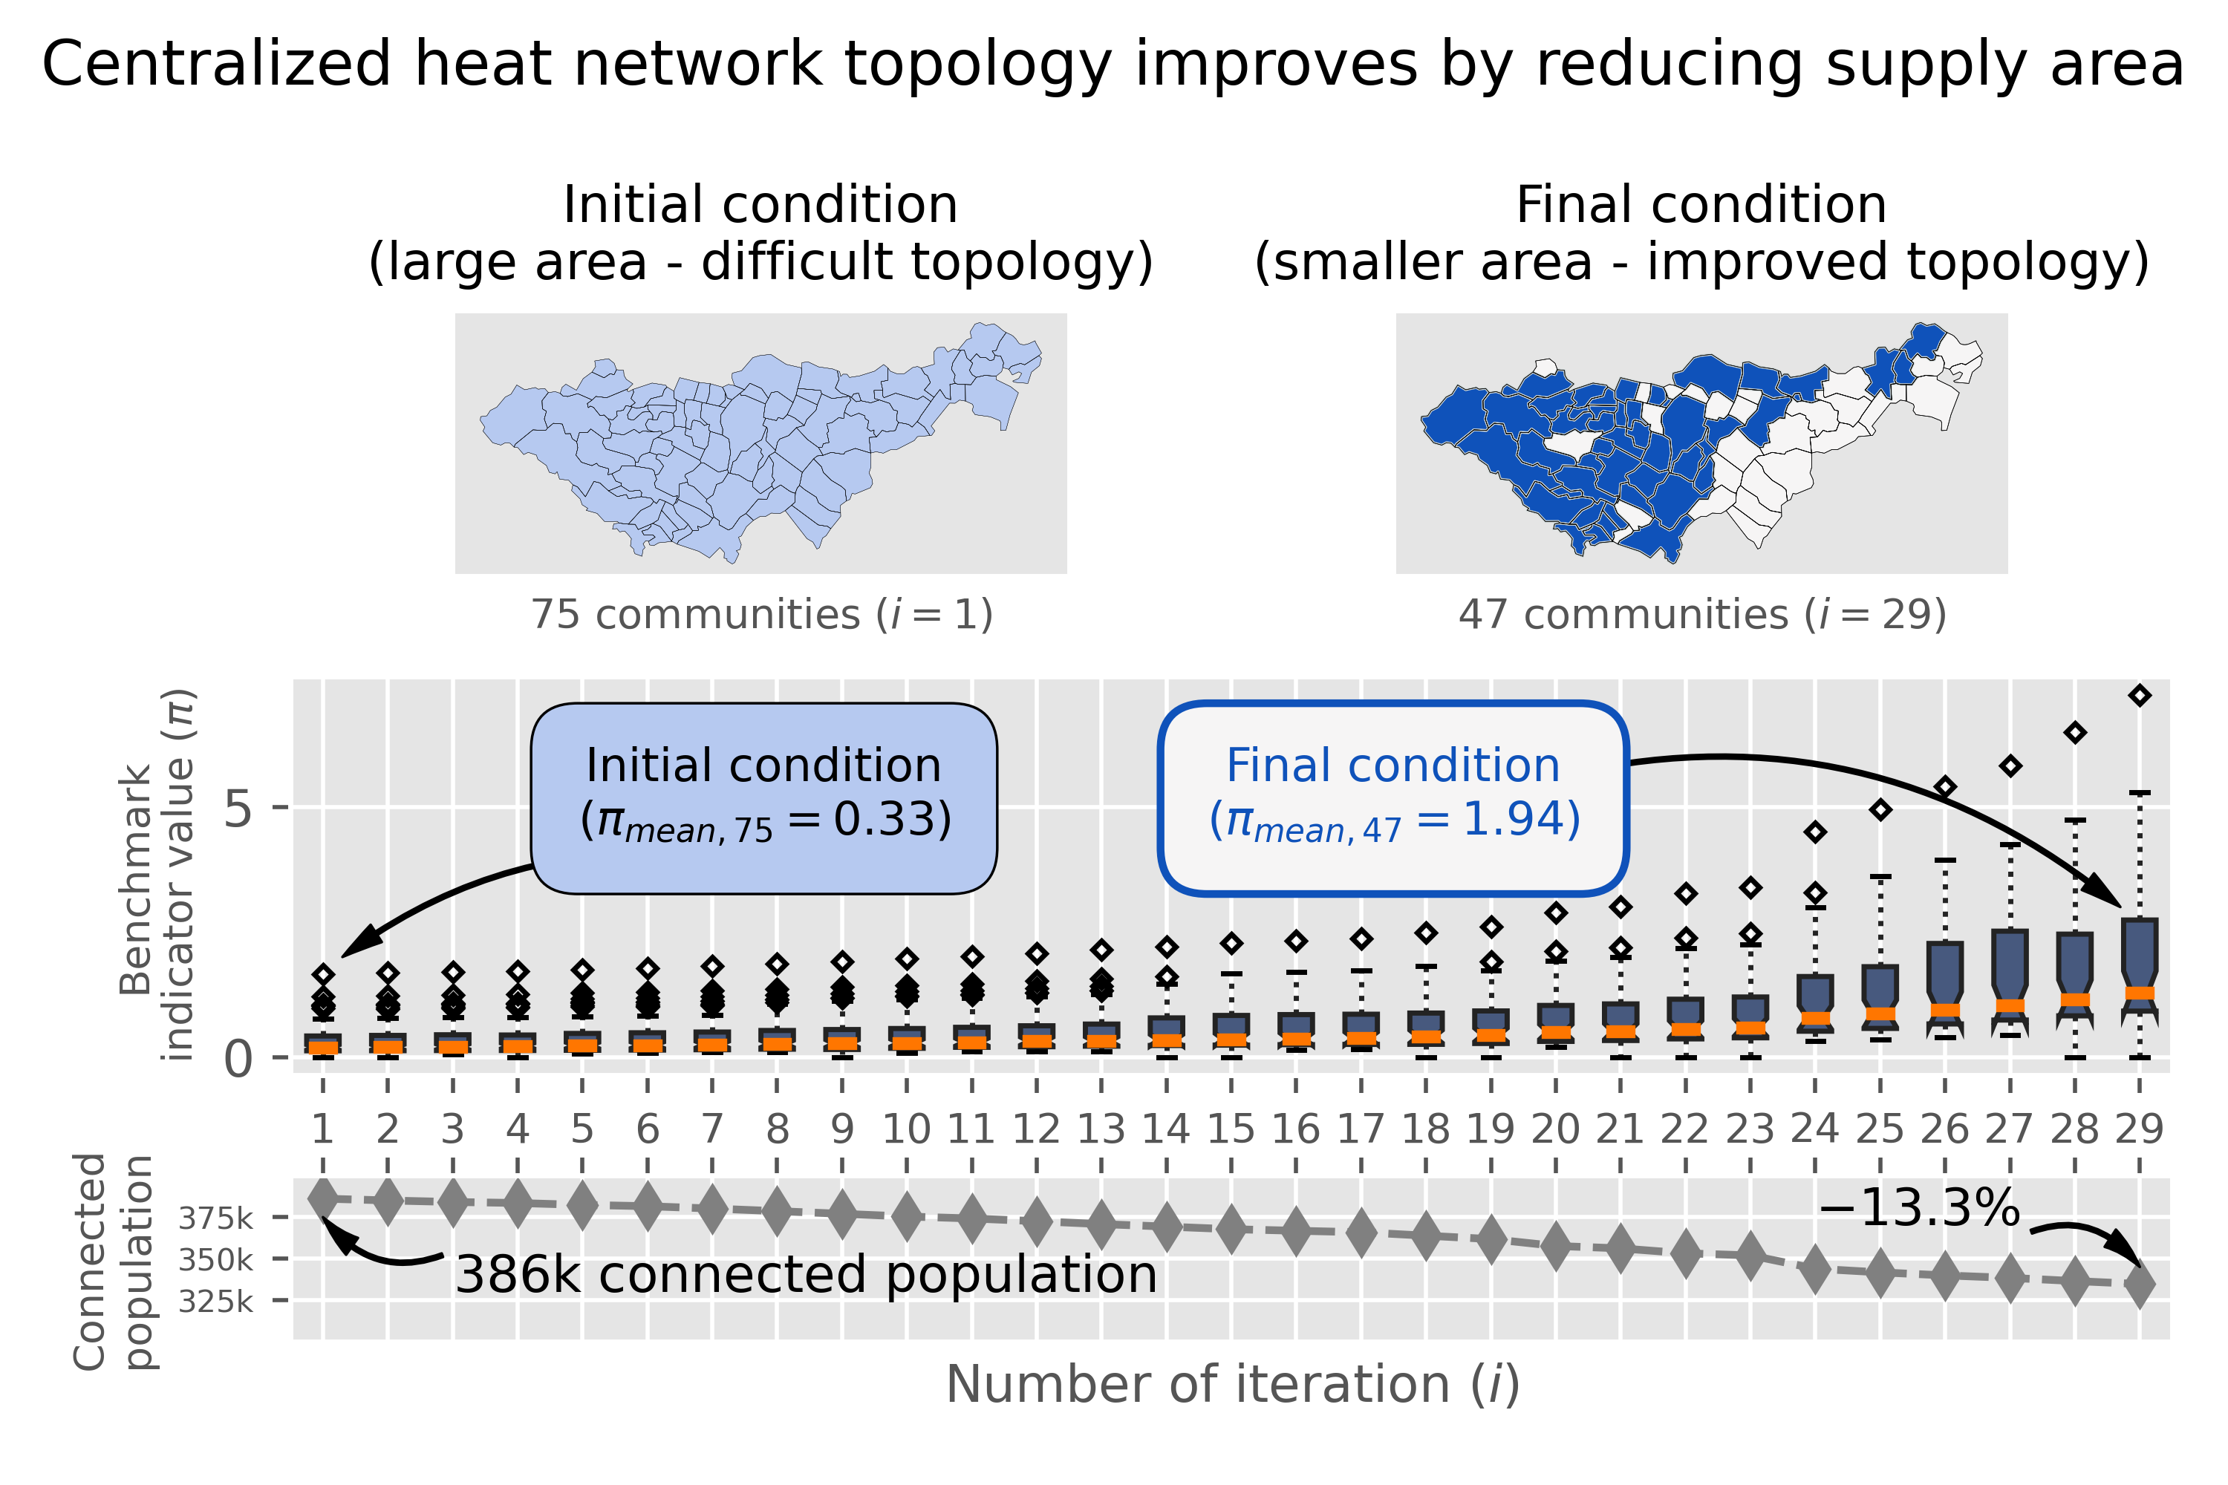

Slide 9
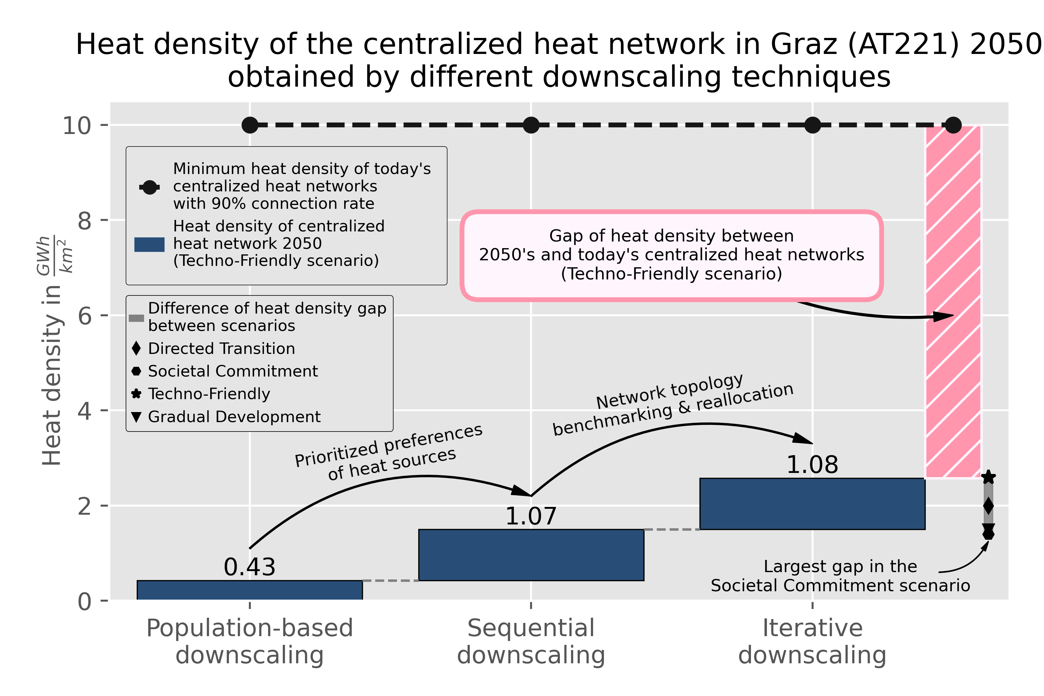

Slide 10
Conclusions
Disaggregating values of the heating sector require more advanced downscaling techniques than proportional downscaling (e.g., the population as a proxy)
Otherwise, misinterpretation of cost-minimal solutions supplying the heat demand and misestimating the potentials of centralized heat networks on the local level
In particular, prioritized preferences and graph theory-based benchmarking can improve the meaningfulness of downscaled values of the heating sector
Despite improved accuracy, a significant reduction of heat densities of centralized heat networks compared to today’s networks is expected by 2050
Incentives for heat supply companies are likely to become necessary to ensure that they provide heat network infrastructure for high efficient and local usage of heat sources

Slide 11

Acknowledgments / References
Collaborators
Daniel Huppmann (International Institute for Applied Systems Analysis)
Antonia Golab (Energy Economics Group – Technische Universität Wien)
Hans Auer (Energy Economics Group – Technische Universität Wien)
References
H. Auer et al. (2020). Development and modelling of different decarbonization scenarios at the European energy system until 2050 as a contribution to achieving the ambitious 1.5°C climate target – establishment of open source/data modelling in the European H2020 project openENTRANCE, e&i Elektrotechnik und Informationstechnik, 1-13. doi: 10.1007/s00502-020-00832-7

